Slide 1
Endocrine & Cell Communication Part I: Introduction to Communication
Notes:
Enduring Understanding 3.D Cells communicate by generating, transmitting and receiving chemical signals.
You may wish to print a copy of slide 20 and distribute it ahead of time. Ask them to use scissors and cut the pieces apart and bring them to class. They will be using the pieces to construct a “concept map” near the conclusion of this lesson.

Slide 2
How does a cell communicate?
He uses a cell phone.
HA HA HA

Slide 3
AP Biology Curriculum Framework
Enduring Understanding 3.D Cells communicate by generating, transmitting and receiving chemical signals.
EK 3D1:Cell communication processes share common features that reflect a shared evolutionary history.
C. In single-celled organisms, signal transduction pathways influence how the cell responds to its environment.
D. In multicellular organisms, signal transduction pathways coordinate the activities within individual cells that support the function of the organism as a whole.
Notes:
Ask students to cite specific examples they’ve learned thus far that involve cell to cell communication.
Emphasize that this “cell communication” concept is a central concept in this course and that students will see it over and over again. Encourage them to choose a specific example of cell communication (or two) for this unit and become an expert on it. Let them practice explaining it in detail to each other. They need to be able to write about 4 points worth on their example when faced with a free response question.

Slide 4
Why do cells need to communicate?
There are many reasons, so name a few.
Notes:
Think about this question. Write an answer on the side of your paper. Show your answer to a neighbor. Sample answers are on the next slide. Expect students to justify/explain their answers.

Slide 5
Why do cells need to communicate?
Here are a few reasons:
Coordinate activities in multicellular organisms
Hormone actions
Cell recognition
To find mates (yeast cells)
Turn pathways on/off
apoptosis
Notes:
Coordinate activities such as development and movement, hormones and neurotransmitters are chemical communications, cell recognition such as for antibodies, yeast exchange mating factors, pathways such as signal transduction pathway that are a series of steps by which a signal on the cell’s surface is converted to a specific cellular response, and apoptosis is a type of programmed cell death (think embryonic development of fingers and toes, the disappearance of a tadpole’s tail, etc.), just to name a few.

Slide 6
http://www.dnalc.org/resources/3d/cellsignals.html
Cell signaling video clip from DNA Learning Center

Slide 7
Evolutionary ties of cell communication
Cell-to-cell communication is everywhere in biological systems from Archaea and bacteria to multicellular organisms.
The basic chemical processes of communication are shared across evolutionary lines of descent.
Signal transduction is an excellent example

Slide 8
Signal Transduction Animation
Click on this link to access the animation:
http://www.wiley.com/college/boyer/0470003790/animations/signal_transduction/signal_transduction.htm
Notes:
At this point, we just want to introduce the concept of signal transduction. Preface this animation with a brief discussion of the “fight or flight” response. “Imagine observing a bear in its natural habitat…” is an appropriate introduction, then click on the animation link. Only explore the “overview” portion of the animation at this time.

Slide 9
Chemical Communication
Outside the body
Ex. Pheromones
Inside the body
Short Distance
Long Distance
Ex. Quorum sensing
Notes:
Pheromones are chemicals that are produced by organisms to aid in communication by members of the same species, quorum sensing is used by organisms to react as a group usually in bacteria.

Slide 10
Pheromones
Members of the same animal species sometimes communicate with pheromones, chemicals that are released into the environment.
Pheromones serve many functions, including marking trails leading to food, defining territories, warning of predators, and attracting potential mates.
Here’s an example of a termite following a “manmade” trail: http://edutube.org/en/video/termites-and-pheromones-ink-trails
Notes:
The video shows a gentleman laying down a PaperMate Ink trail on a plain white piece of paper. Next, he places a termite onto the paper and within seconds the termite follows the trail (with a bit of trial and error on the termite’s part). Students love this!

Slide 11
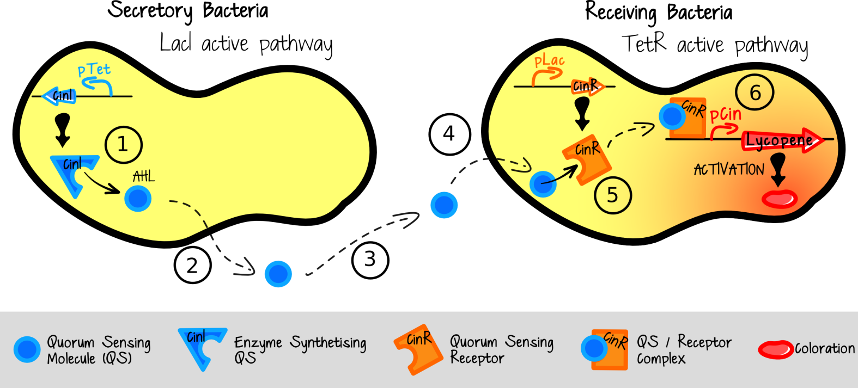
Quorum sensing
Quorum sensing in bacteria – single celled bacteria monitor their environment by producing, releasing and detecting hormone-like molecules called autoinducers.
Notes:
This process, termed quorum sensing, allows bacteria to monitor the environment for other bacteria and to alter behavior on a population-wide scale in response to changes in the number and/or species present in a community. THERE IS NO NEED TO DESCRIBE THE DETAILS of the image shown.

Slide 12
Chemical Communication
Inside the body
Short Distance
Long Distance
Paracrine
Autocrine
Hormones
Example Prostaglandin
Example Interleukin
Example Insulin
Notes:
This flow chart shows a simplified classification system for the cell communication occurring within the body. The dividing lines between hormones, paracrine and autocrine signals have blurred. In our study of hormones we will mostly focus on hormones as long distance communicators. Paracrine refers to a secreted molecule that acts on a neighboring cell, autocrine refers to a secreted molecule that acts on the cell that secreted it.

Slide 13
AP Biology Curriculum Framework
EK 3.D.2 Cells communicate with each other through direct contact with other cells or from a distance via chemical signaling.
a. Cells communicate by cell-to-cell contact.
b. Cells communicate over short distances by local regulators that target cells in the vicinity of the emitting cell.
c. Signals released by one cell type can travel long distances to target cells of another type.

Slide 14
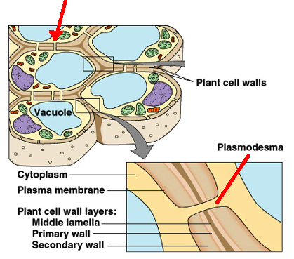
Direct Contact Communication
Ex. Plant cells communicate directly through openings called plasmodesmata.
Notes:
Another example would be helper T cells bind with Killer T cells in the immune system.

Slide 15
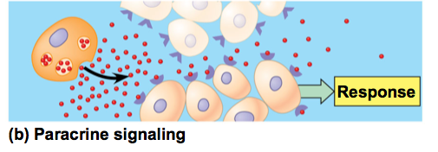
Short Distance Communication
Paracrine signals diffuse to and affect nearby cells
Ex. Neurotransmitters
Ex. Prostaglandins
Notes:
The next four slides outline the different “categories” of cell to cell communications involved in the endocrine system. Students should know an example for each one as well as the basics of how each type of communication works.
Paracrine chemical signals work in cells that are near the secreting cell. For example, neurotransmitters released by a presynaptic cell move across the synapse and impact the post synaptic cell.
In the immune system, prostaglandins promote fever and inflammation and intensify the sensation of pain.
Prostaglandins help regulate aggregation of platelets, an early step in formation of blood clots.

Slide 16
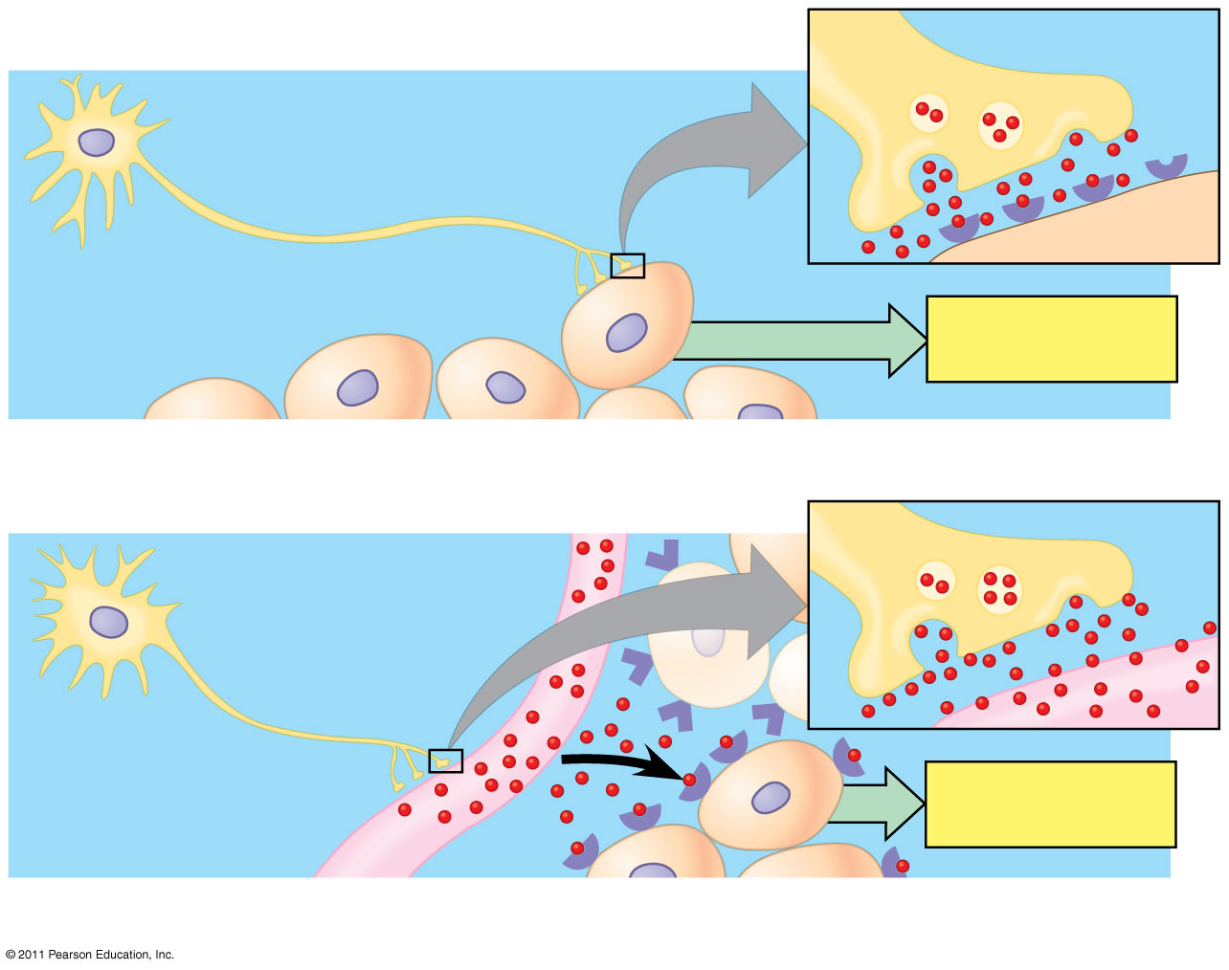
Neurotransmitters and Neurohormones
Neuron
Synapse
Response
Synaptic signaling
Neurosecretory cell
Blood vessel
Response
Neuroendocrine signaling
Notes:
Intercellular communication by secreted molecules.

Slide 17
Autocrine signals
These chemicals affect the same cells that release them.
Ex. Interleukin-1 produced by monocytes and can bind to receptors on the same monocyte.
Tumor cells reproduce uncontrollably because they self-stimulate cell division by making their own division signals.
Notes:
Again…students need to become an expert on “an” example while have knowledge of various examples.

Slide 18
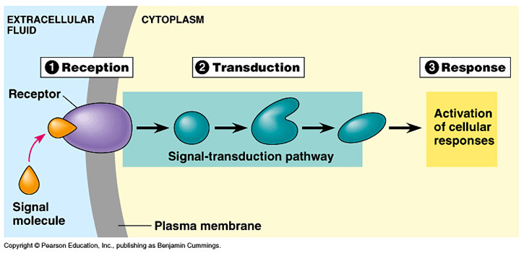
Long Distance Communication
Endocrine hormones via signal transduction pathway:
Notes:
The word transduce means to convert. A signal transduction pathway “converts” the original signal molecule into a cellular response. This conversion requires several intermediate messenger molecules (sometimes called “second messengers”), so the signal is actually “converted” or transduced several times, as shown in the blue box above labeled Transduction. The concept of signal transduction pathways will be seen over and over again in AP Biology and is certain to be on the exam.

Slide 19
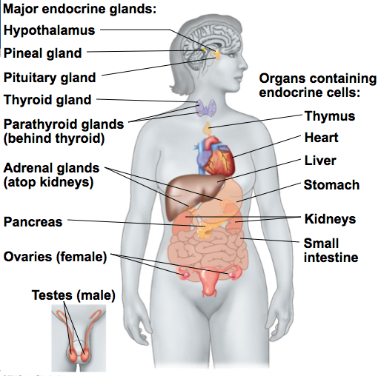
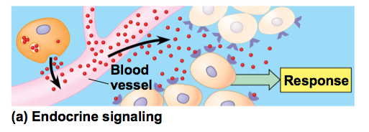
Hormones
Endocrine glands produce hormones which are
Chemical signals
Transported in tissue fluids
Detected only by target cells
Notes:
Ask students to name some hormones. Testosterone and estrogen are sure to be in their list! Either of those make perfect “expert” examples.

Slide 20
Practice: Use the labels provided to create a cell communication graphic organizer.
Long Distance Signaling | Pheromone | Autocrine Signaling | Oxytocin
Short Distance Signaling | Quorum Sensing | Interleukin | Neuro- transmitter
Outside the Body Signaling | Paracrine Signaling | Prostaglandin | Direct contact communication
Inside the Body Signaling | Endocrine Signaling | Testosterone | Estrogen
Notes:
Students are basically being asked to create a concept map. You may wish to print a copy of this slide and distribute it ahead of time. Ask them to use scissors and cut the pieces apart and bring them to class.

Slide 21
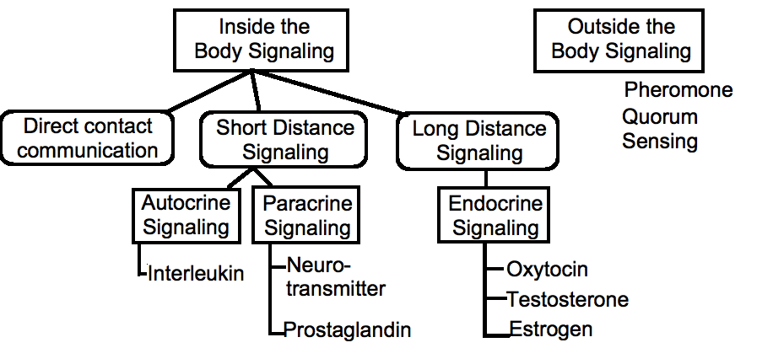
How does your arrangement compare?
Possible Solution
Notes:
Allow students to correct their misconceptions before moving on. It would be great if they could leave class with a complete and ACCURATE concept map!

Slide 22
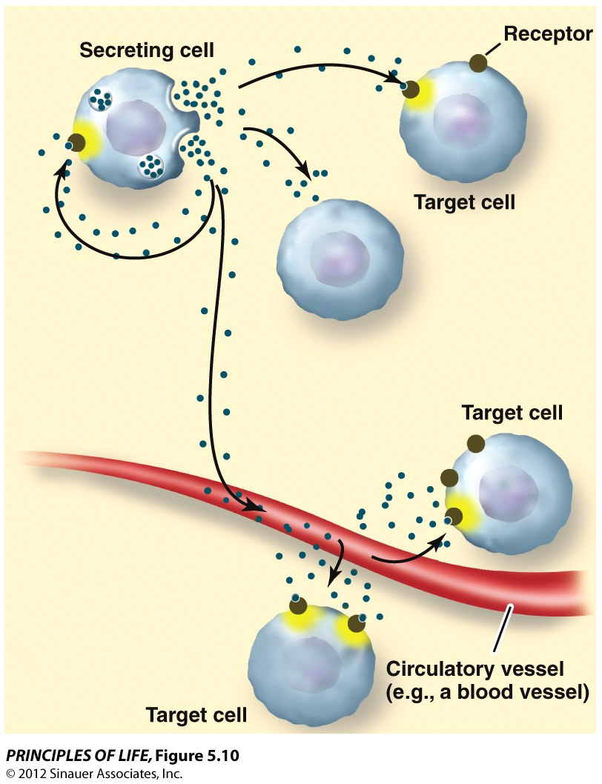
Communication Features
Secreting cell - releases the signal
Signal = chemical = ligand
Receptor - accepts and temporarily joins with the ligand forming receptor/ligand complex
Target cell – contains the receptor
Notes:
A ligand is in a narrow sense, a signal triggering molecule, binding to a site on a target protein. The word “binding” refers to intermolecular forces (IMFs) rather than an actual chemical (covalent or ionic) bond. While actual chemical bonds can form, it is very rare. It is far more common for the “binding” to be more of an electrostatic attraction. You can demonstrate this for students using small pieces of torn paper and an ordinary comb. “Charge” the comb by combing it through someone’s hair (ions from the keratin protein of hair will adhere to the plastic comb). The comb will then attract the small pieces of paper. It is obvious that these attractions are not actual chemical bonds.
Historical note: In 1970, Dr. Martin Rodbell examined the effects of glucagon on a rat's liver cell membrane receptor. He noted that guanosine triphosphate disassociated glucagon from this receptor and stimulated the G-protein, which strongly influenced the cell's metabolism. Thus he deduced that the G-protein was a transducer that accepted glucagon molecules and affected the cell. For this he shared the 1994 Nobel Prize in Physiology or Medicine with Dr. Alfred G. Gilman. Dr. Gilman became Chairman of the Department of Pharmacology at the University of Texas Southwestern Medical Center in 1981 and then in 2006 he became Executive Vice President for Academic Affairs and Provost of the University of Texas Southwestern Medical Center in Dallas, TX. In short, he is a teacher as well as a Nobel Prize Winner! He has worked with the NMSI science staff on several teacher training projects including the development of a virtual microscope. He is a long standing supporter of LTF and of NMSI and an advocate of science education.

Slide 23
Apply the features
Insulin is secreted by beta cells of the pancreas. Once secreted, insulin travels around the body. When insulin docks with an integral protein on the membrane of a muscle cell, glucose can enter the cell.
What is the secreting cell, the target cell, ligand, and the receptor?
Notes:
Insulin makes another excellent “expert” example. Students often know someone who is diabetic, so they may have a keen interest in learning more about diabetes.
Secreting cells are the pancreatic beta cells. Target cells (in this example) are muscle cells. The ligand is insulin. The receptor is an integral protein in the membrane of the muscle cell.

Slide 24
The Endocrine System
Notes:
You may wish to print copies of Slide 7 & Slide 20 prior to class. Students are asked to label that diagram as we proceed throughout this lesson.

Slide 25
AP Biology Curriculum Frameworks
EK 3.D.1 Cell communication processes share common features:
d. In multicellular organisms, signal transduction pathways coordinate the activities within individual cells.
EK 3D.2 Cells communicate with each other through direct contact with other cells or from a distance via chemical signaling.
c. Signals released by one cell type can travel long distances to target cells of another cell type.
1. Endocrine signals are produced by endocrine cells that release signaling molecules, which are specific and can travel long distances through the blood to reach all parts of the body.

Slide 26
Notes:
While it is not necessary to memorize every cell type or gland found within the system, it will be helpful to recognize the endocrine glands and the function of the hormones produced by select glands to use as examples of how both short and long distance chemical communication occurs.
In addition to the specialized endocrine organs mentioned above, many other organs that are part of other body systems, such as the kidney, liver, heart and gonads, have secondary endocrine functions. For example the kidney secretes endocrine hormones such as erythropoietin and renin.

Slide 27
The Endocrine System works with the Nervous System
Two systems coordinate communication throughout the body: the endocrine system and the nervous system.
The endocrine system secretes hormones that coordinate slower but longer-acting responses including reproduction, development, energy, metabolism, growth, and behavior.
The nervous system conveys high-speed electrical signals along specialized cells called neurons; these signals regulate other cells.
Notes:
The endocrine system is made of a series of glands that produce chemicals called hormones. A number of glands that signal each other in sequence are usually referred to as an axis, for example, the hypothalamic-pituitary-adrenal axis.

Slide 28
Coordination of Endocrine and Nervous Systems in Vertebrates
The hypothalamus receives information from the nervous system and initiates responses through the endocrine system.
Attached to the hypothalamus is the pituitary gland, composed of the anterior pituitary and the posterior pituitary.
The anterior pituitary makes and releases hormones under regulation of the hypothalamus.
The posterior pituitary stores and secretes hormones that are made in the hypothalamus.
© 2011 Pearson Education, Inc.
Notes:
Ask students if they know the locations of the hypothalamus, anterior pituitary gland and posterior pituitary gland. They illustrated on the next slide.

Slide 29
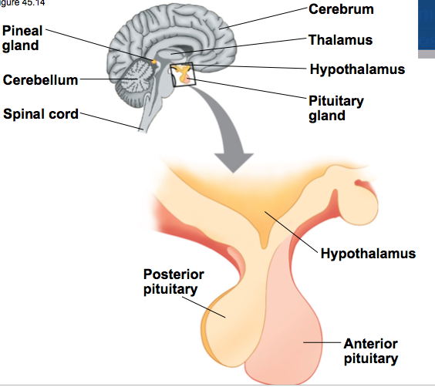
Anterior and Posterior Pituitary
© 2011 Pearson Education, Inc.

Slide 30
Posterior Pituitary Hormones
The two hormones released from the posterior pituitary act directly on nonendocrine tissues.
Oxytocin regulates milk secretion by the mammary glands and stimulates contraction of the uterus.
Antidiuretic hormone (ADH) promotes retention of water by the kidneys.
Notes:
Discuss with students the implications of alcohol and diabetes on ADH. Alcohol consumption reduces ADH production resulting in an increase in production of urine. In diabetes insipidus, the pituitary gland produces insufficient ADH which again increases the production of urine.

Slide 31
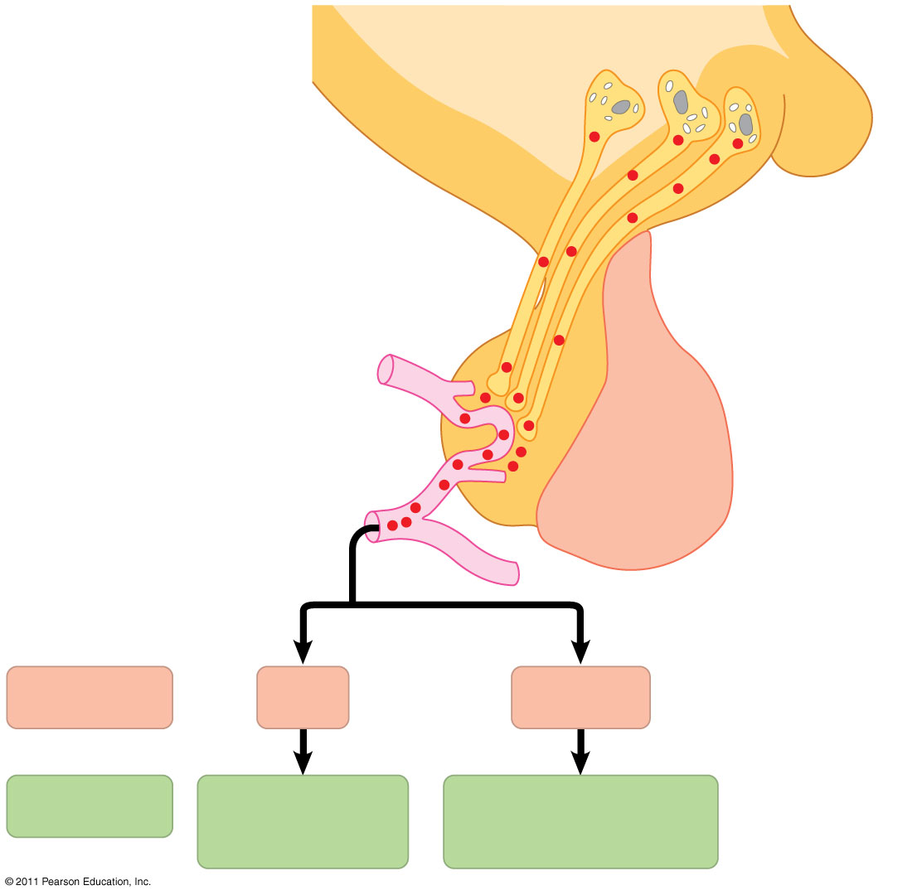
Production and Release of Posterior Pituitary Hormones
Neurosecretory cells of the hypothalamus
Hypothalamus
Neurohormone
Axons
Posterior pituitary
Anterior pituitary
HORMONE
ADH
Oxytocin
TARGET
Kidney tubules
Mammary glands, uterine muscles
Notes:
Production and release of posterior pituitary hormones.

Slide 32
Anterior Pituitary Hormones
Hormone production in the anterior pituitary is controlled by releasing and inhibiting hormones from the hypothalamus.
For example, prolactin-releasing hormone from the hypothalamus stimulates the anterior pituitary to secrete prolactin (PRL), which has a role in milk production and secretion.
Another example is Thyroid Stimulating Hormone (TSH), which stimulates the thyroid gland to produce thyroxine which stimulates and maintains metabolic processes.
Notes:
Ask students if they know what “lactose intolerant” means. Don’t miss the opportunity to make the connection between lactose (milk sugar) and prolactin.

Slide 33
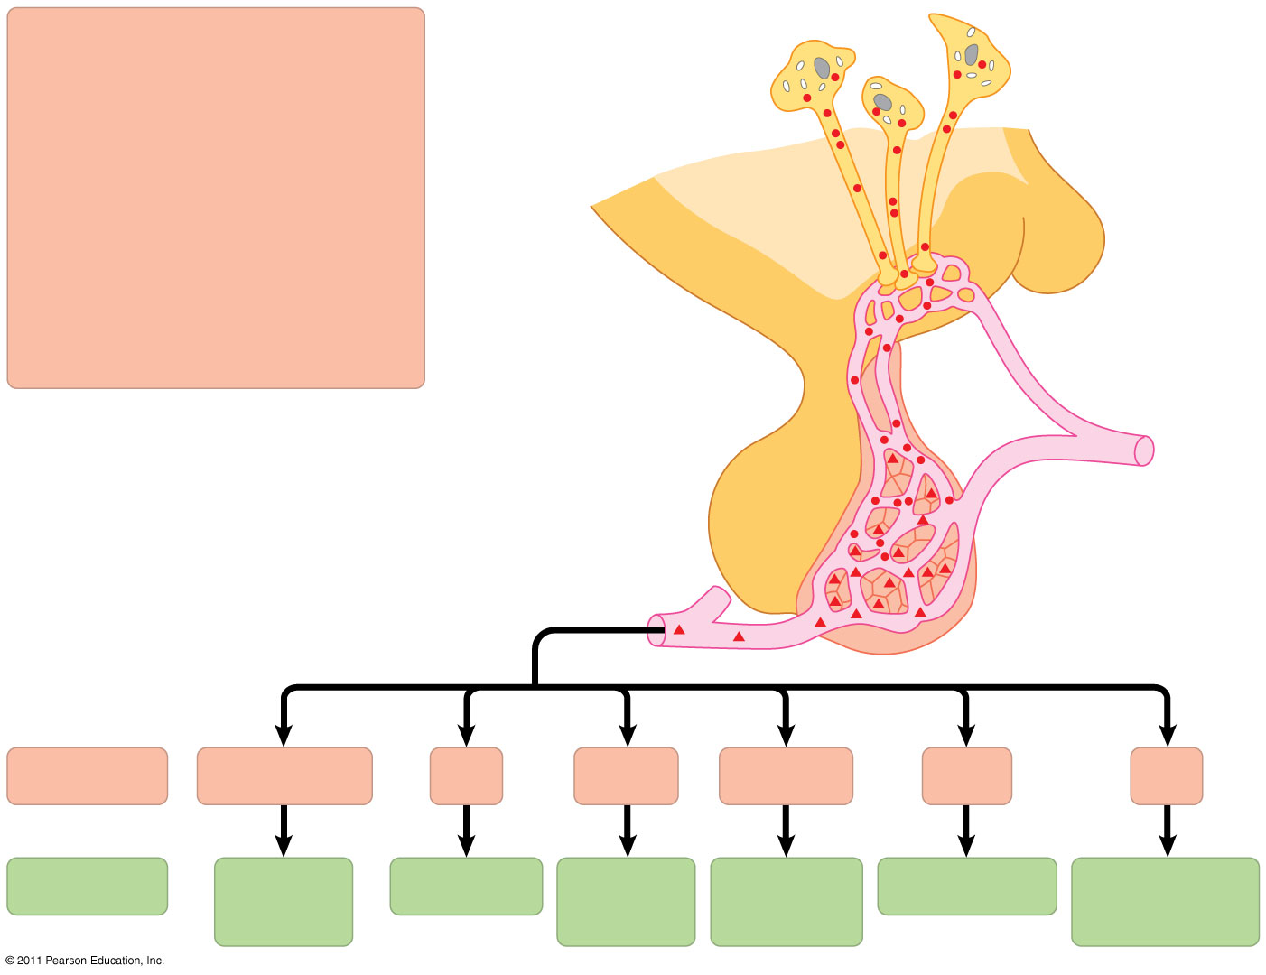
Figure 45.16
Tropic effects only: FSH LH TSH ACTH
Neurosecretory cells of the hypothalamus
Nontropic effects only: Prolactin MSH
Nontropic and tropic effects: GH
Hypothalamic releasing and inhibiting hormones
Portal vessels
Endocrine cells of the anterior pituitary
Posterior pituitary
Pituitary hormones
HORMONE
FSH and LH
TSH
ACTH
Prolactin
MSH
GH
TARGET
Testes or ovaries
Thyroid
Adrenal cortex
Mammary glands
Melanocytes
Liver, bones, other tissues
Notes:
Production and release of anterior pituitary hormones. “Tropic” hormones are those that target other endocrine glands; so “tropic effects” above refers to hormones produced by the anterior pituitary that in turn stimulate/control other endocrine glands.

Slide 34
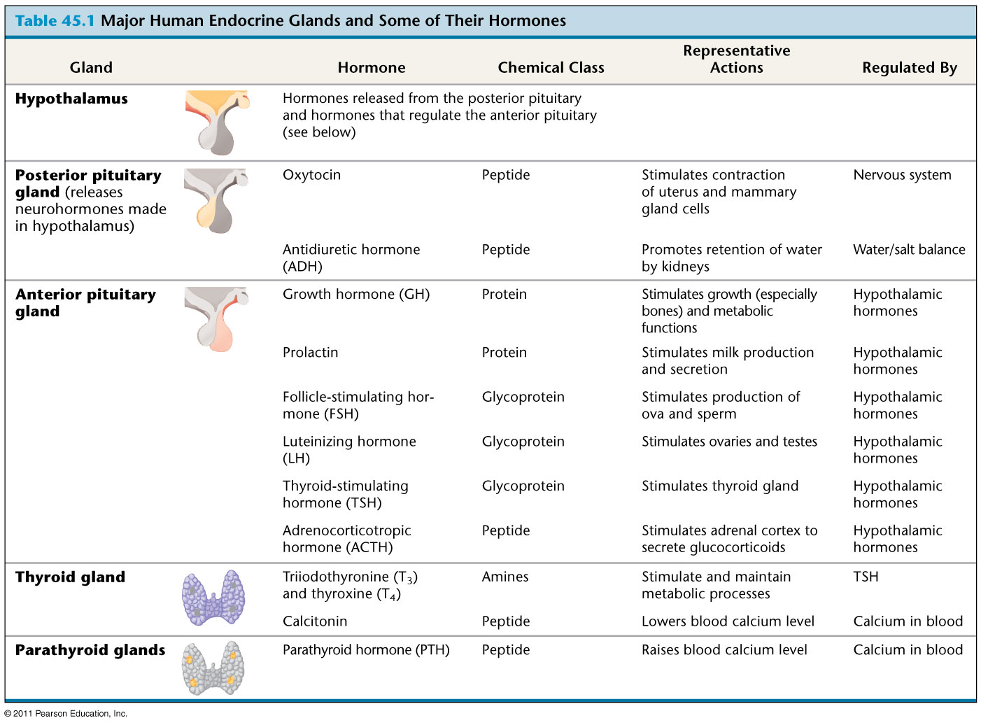
Table 45.1a
Notes:
Major Human Endocrine Glands and Some of Their Hormones. Have students “pick a favorite” from either this slide or the next so they can use it as an example in their free-response writing.

Slide 35
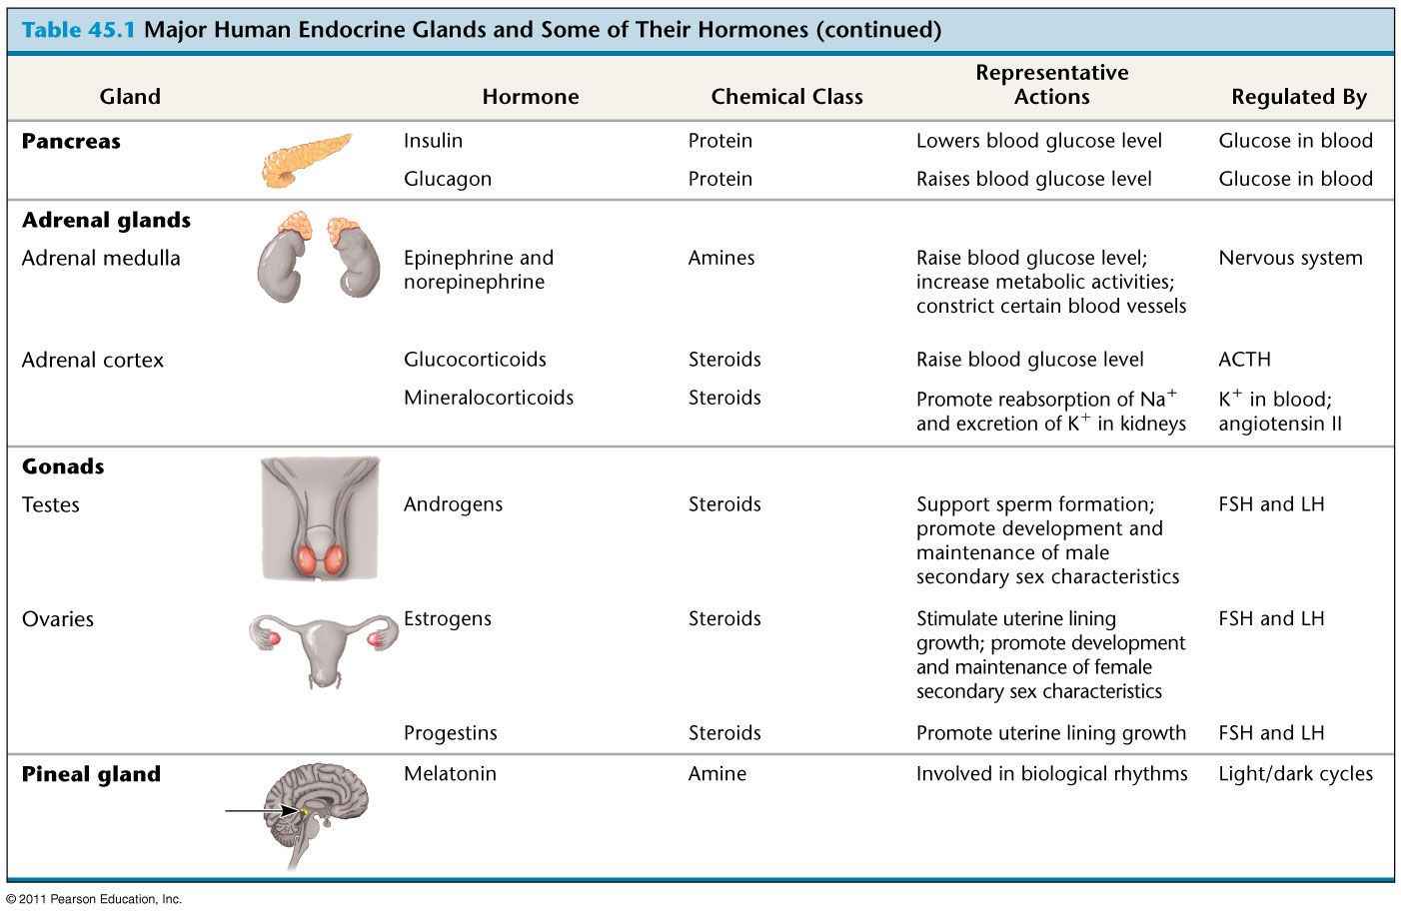
Table 45.1b
Notes:
Major Human Endocrine Glands and Some of Their Hormones

Slide 36
Pick a Gland
Name the gland
Name the Hormone
Describe the hormone’s role in the body

Slide 37
Long Distance Communication
Endocrine hormones via signal transduction pathway:
Notes:
The word transduce means to convert. A signal transduction pathway “converts” the original signal molecule into a cellular response. This conversion requires several intermediate messenger molecules (sometimes called “second messengers”), so the signal is actually “converted” or transduced several times, as shown in the blue box above labeled Transduction. The concept of signal transduction pathways will be seen over and over again in AP Biology and is certain to be on the exam.

Slide 38
The Process of Communication: Signal-Transduction Pathway
Three stages of the Signal-Transduction Pathway
1. reception
2. transduction
3. response
Notes:
Most cell communication involves three basic steps, reception, transduction and response. Today, we will see this signal transduction pathway being initiated by hormones. We will look at specific examples of how communication is completed using this pathway.

Slide 39
Long Distance Communication
Endocrine hormones via signal transduction pathway:
Notes:
The word transduce means to convert. A signal transduction pathway “converts” the original signal molecule into a cellular response. This conversion requires several intermediate messenger molecules (sometimes called “second messengers”), so the signal is actually “converted” or transduced several times, as shown in the blue box above labeled Transduction. The concept of signal transduction pathways will be seen over and over again in AP Biology and is certain to be on the exam.

Slide 40
Ligands
LIGAND: a molecule that binds to a larger molecule
Notes:
The transduction pathway at the target cell begins when the ligand binds to the receptor forming a temporary ligand/receptor complex. This stimulates transduction which leads to a response from the cell. Have students cite some examples of ligands.

Slide 41
Ligand = Chemical Messenger
Three major classes of molecules function as hormones in vertebrates (ligands)
Polypeptides (proteins and peptides)
Amines derived from amino acids
Steroid hormones
Notes:
The hormones we consider today fall into three main categories. Polypeptides, amines and steroid hormones. The chemical make up of each is different so it is not surprising that these ligands impact cells very differently.

Slide 42
Ligand = Chemical Messenger
Three major classes of molecules function as hormones in vertebrates (ligands)
Polypeptides (proteins and peptides)
Amines derived from amino acids
Steroid hormones
Notes:
The hormones we consider today fall into three main categories. Polypeptides, amines and steroid hormones. The chemical make up of each is different so it is not surprising that these ligands impact cells very differently.

Slide 43
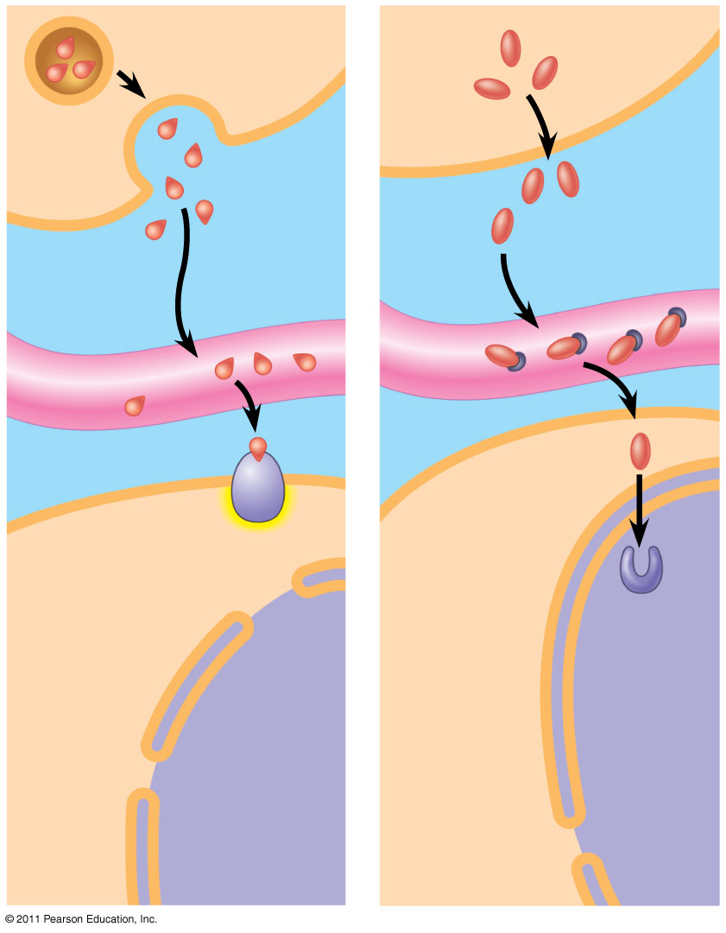
SECRETORY CELL
Water- soluble hormone
Lipid- soluble hormone
VIA BLOOD
Transport protein
Signal receptor
TARGET CELL
Signal receptor
NUCLEUS
(a)
(b)
Notes:
Receptor location varies with hormone type. Notice that the water soluble hormones, such as epinephrine or insulin, bind with a membrane bound receptor protein while the lipid soluble hormone can pass directly through the membrane of the target cell to dock with an intracellular receptor..

Slide 44
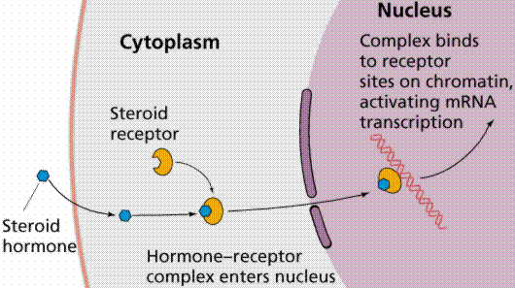
Steroid Hormone Example: Testosterone
Notes:
Explain the pathway of a steroid hormone using testosterone as an example. Pick a male student with a moustache as your example and explain how testosterone from the testes is secreted and moves into the blood stream The testosterone would move around the male’s body. However, follicular cells have testosterone receptors and respond to the presence of this hormone. Once inside the follicle cell of the lip, the testosterone stimulates the cell to produce keratin by “turning on” the segment of DNA that codes for the protein.”

Slide 45
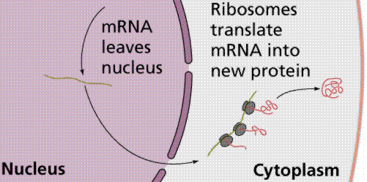
Notes:
In this case the protein produced could be keratin.

Slide 46
Model Steroid Hormone Action using the Testosterone Manipulative
Notes:
Have students take turns explaining the action of a steroid hormone using the model provided. (Pig hair from a paint brush can serve as the keratin produced in this pathway). Hold students accountable for the activity by having them write a list of steps in the pathway from secretory cell to keratin produced.

