Slide 1
Nuclear Chemistry

Slide 2
Difference between “Regular” Chemistry and Nuclear Chemistry
Regular Chemistry
Nuclear Chemistry
Reactions involve changes in the outer electronic structures of atoms or molecules.
Reactions are accompanied by absorption or release of a relatively small amount of energy.
Rates of reaction are influenced by temperature, pressure, concentration, and catalysts.
Reactions result from changes taking place within atomic nuclei.
Reactions are accompanied by absorption or release of tremendous amounts of energy.
Rates of reaction are typically not affected by temperature pressure and catalysts.

Slide 3
Remember…
Atomic Mass #
12
C
Element Symbol
6
Atomic Number
Isotopes – atoms of the same element with different numbers of neutrons.

Slide 4
Nuclear Equations
Nuclear equations must be balanced with respect to
Nuclear charge (atomic number) AND
Nuclear mass (mass number)
Ex)
$${}_{7}^{14}{N + {}_{0}^{1}{n → {}_{6}^{14}{C + {}_{1}^{1}H}}}$$
The reactants are an N-14 nucleus and a neutron.
The products are a C-14 nucleus and a H-1 nucleus.
The atomic numbers add to 7 on both sides.
The mass numbers add to 15 on both sides.

Slide 5
Radioactivity
An unstable nucleus is radioactive, and unstable isotopes are called radioactive isotopes.
A radioactive nucleus spontaneously decomposes (“decays”) with the evolution of energy.
In doing so, radioactive decay actually changes one chemical element (parent) to another element (daughter product).
If the daughter product is unstable (radioactive) it will decay to another isotope.
If the daughter product is stable, it will remain as is and will no longer decay.

Slide 6
Modes of Decay
Naturally occurring radioactive nuclei commonly decompose by
alpha particle emission (α)
beta particle emission (β)
gamma radiation emission (γ)

Slide 7
Alpha Particle Emission
An alpha particle is a positively charged ${}_{2}^{4}{He}$ nucleus.
If an unstable nucleus emits an alpha particle, its atomic number decreases by 2 and its atomic mass decreases by 4.
Ex) The decay of thorium-232
$${}_{90}^{232}{Th → {}_{88}^{228}{Ra + {}_{2}^{4}{He}}}$$
thorium-232 radium-228 alpha particle

Slide 8
Alpha Particle Emission cont.
Large, heavy elements, such as uranium and thorium, tend to undergo alpha emission.
This decay mode relieves the nucleus of two units of positive charge (protons) and four units of mass (mass #) each time an alpha particle is emitted.
Hence the composition of the alpha particle…
$${}_{2}^{4}{He}$$

Slide 9
Beta Particle Emission
A beta particle is an electron. The symbol used in nuclear equations is ${}_{−1}^{0}e$
In beta particle emission, electrons are emitted from within atomic nuclei, NOT from surrounding electronic orbitals.
The beta particles arise from the decay of a neutron to a proton.
$n^{0}→ p^{+} + e^{−}$
The creation of the proton causes the atomic number to increase by one.

Slide 10
Beta Particle Emission cont.
Ex) The decay of lead-212.
$${}_{82}^{212}{Pb → {}_{83}^{212}{Bi + {}_{−1}^{0}e}}$$
The atomic number increased to 83 due to the new proton.
The atomic mass stays the same in beta particle emission.

Slide 11
Beta Particle Emission cont.
Isotopes with a high neutron/proton ratio often undergo beta emission.
this decay mode allows the number of neutrons to be decreased by one
and
the number of protons to be increased by one
thus lowering the neutron/proton ratio.

Slide 12

Gamma Radiation Emission
There is no mass change associated with gamma emission.
Gamma radiation emission is similar to x-rays – high energy, short wavelength radiation.
Gamma radiation commonly accompanies both alpha and beta emission, but it’s usually not shown in a balanced nuclear reaction.
$${}_{0}^{0}γ$$

Slide 13
Gamma Radiation Emission
Some isotopes, such as Cobalt-60 (Co-60), give off large amounts of gamma radiation.
Co-60 is used in the radiation treatment of cancer.
The medical personnel focus gamma rays on the tumor, thus destroying it.

Slide 14
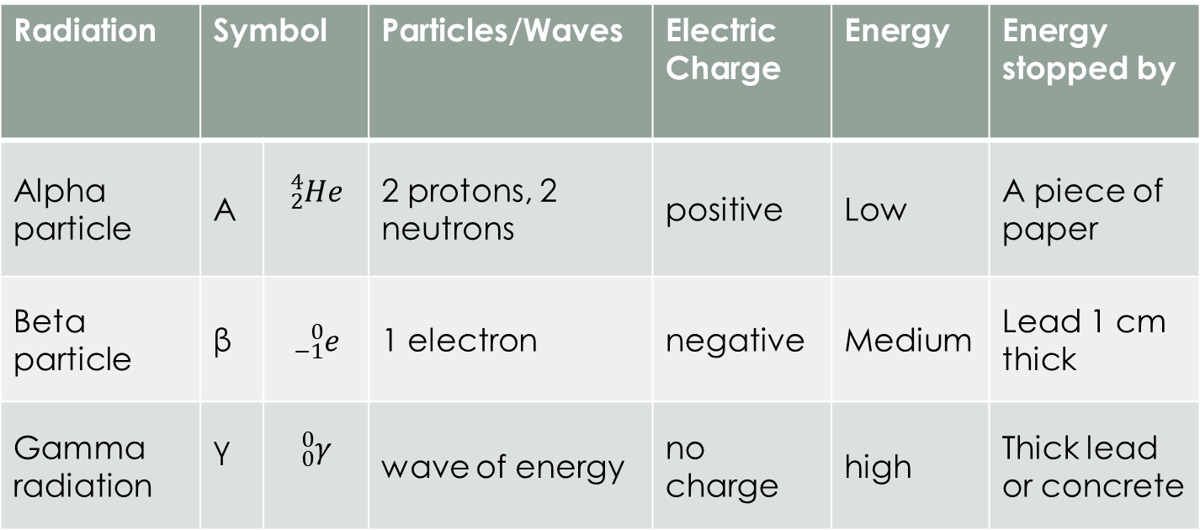
Summary of Particles
Radiation | Symbol |  | Particles/Waves | Electric Charge | Energy | Energy stopped by
Alpha particle | Α | $${}_{2}^{4}{He}$$ | 2 protons, 2 neutrons | positive | Low | A piece of paper
Beta particle | β | $${}_{−1}^{0}e$$ | 1 electron | negative | Medium | Lead 1 cm thick
Gamma radiation | γ | $${}_{0}^{0}γ$$ | wave of energy | no charge | high | Thick lead or concrete

Slide 15
Radioactive Decay
Decay happens in a particular order, over a particular period of time.
The amount of time it takes for ½ of the atoms of a radioactive sample to decay is called the half-life of the isotope.
Ex) Radium-226 has a half-life of 1,602 years. If a 10g sample of ²²⁶Ra is placed in a weighing dish and left in a locked vault, how much will be in the weighing dish after 1,602 years?
5 g ²²⁶Ra

Slide 16
Fission Reactions
Splits atoms
During a fission reaction a large isotope is bombarded with a second smaller one (commonly a neutron).
This causes the larger isotope to break apart into two or more elements.
Ex) ${}_{92}^{235}{U→ {}_{36}^{94}{Kr + {}_{56}^{139}{Ba + 2{}_{0}^{1}n}}}$

Slide 17
Fission Reactions
These reactions release a LOT of energy.
Where does the energy come from?
When you make VERY accurate measurement of the masses of all the atoms and subatomic particles you start with and all the atoms and subatomic particles you end up with, and then compare the two, you find there’s some “missing” mass.
Matter disappears during the nuclear reaction.
This loss of matter is called the mass defect.
The missing matter is converted to energy.

Slide 18
FIssion Reactions
You can calculate the amount of energy produce during a nuclear reaction using the equation
E=mc²
E is the amount of energy produced
m is the “missing” mass
c is the speed of light
The speed of light is squared, making that part of the equation a very large number that, even when multiplied by a small amount of mass, yields a LARGE amount of energy.

Slide 19
FIssion Reactions
The atomic bombs dropped on Hiroshima, Japan on August 6, 1945 and on Nagasaki, Japan on August 9, 1945 were both fission reactions.
In an atomic bomb, two pieces of a fissionable isotope are kept apart until it’s time for the bomb to explode.
Conventional explosive force the two pieces together to cause a critical mass.
Once you have reached critical mass, the chain reaction is uncontrollable, releasing a tremendous amount of energy almost instantly.

Slide 20
Fusion Reactions
Essentially the opposite of a fission reaction.
A process by which lighter nuclei are fused into a heavier nucleus. This is the process that powers the Sun.
In a series of nuclear reactions, 4 isotopes of H-1 are fused into a He-4 with the release of a tremendous amount of energy.
$${}_{1}^{2}{H + {}_{1}^{3}H → {}_{2}^{4}{He + {}_{0}^{1}{n }}}$$

Slide 21
Fusion Reactions
Hydrogen bombs – are a fusion reaction
They are approximately 1000 times as powerful as an ordinary atomic bomb.
The isotopes of hydrogen needed for the hydrogen bomb fusion reaction were placed around an ordinary fission bomb.
The explosion of the fission bomb released the energy needed to provide the activation energy (the energy needed to start the reaction) for the fusion process.

